Slide 1
GraVitoN: A Cross Platform Malware Development Framework
Author : Sina Hatef Matbue, Arash Shirkhorshidi
29th July 2012 ,India Habitat Center, Delhi

Slide 2
If it exists, the GraVitoN is expected to be
mass-less...
which gives it the power to
move to and from universes...
Topic : GraVitoN:whoami

Slide 3
Sina Hatef Matbue
VP of Software Development in ChallenGe Security
AND
Funder of The GraVitoN Project
Topic : GraVitoN::whami

Slide 4
Arash Shirkhorshidi
CEO at ChallenGe Security Co.
Topic : GraVitoN::whoishe

Slide 5
ABOUT GraVitoN
Topic : GraVitoN::Framework::About

Slide 6
A beautiful combination of simple and smart ideas
Topic : GraVitoN::Framework::Purpose

Slide 7
Malware Development Framework
Topic : GraVitoN::Framework::Purpose

Slide 8
Cross platform
Topic : GraVitoN::Framework::Purpose

Slide 9
Highly Customizable
Virus
Trojan
Worm
Topic : GraVitoN::Framework::Purpose

Slide 10
Why GraVitoN
Topic : GraVitoN::Framework::Purpose

Slide 11
C++ and ASM → Fast execution
Object Oriented → Easy to understand
GCC Support → Cross Platform
Doxygen → Well documented code
©License → GPLv3 → Free Software (Free as in freedom) → Hosted at Savannah
Topic : GraVitoN::Framework::Why

Slide 12
Technical Details
Topic : GraVitoN::Framework::Why

Slide 13
Self Exploitable Code
Topic : GraVitoN::Framework::SelfExploitation

Slide 14
Main Idea
Load your payload assembly code as an unsigned char array to memoy
Jump into your payload start address
Topic : GraVitoN::Framework::MainIdea

Slide 15
Let’s Go Code
Initialize Payload Memory
Initialize jumper as a C++ function
Topic : GraVitoN::Framework::Code

Slide 16
Let’s Go Code!
Copy our payload assembly code into memory of our function
And…
Jump!
Topic : GraVitoN::Framework::Code

Slide 17
Let’s Go Code!
Put things together
target: Windows 7 32 bit
payload: payload/windows/messagebox
IDE: dev-cpp
Compiler: g++
Topic : GraVitoN ::Framework::Handson

Slide 18
GraVitoN Framework
Topic : GraVitoN ::Framework::Handson

Slide 19
Component
Topic : GraVitoN ::Component

Slide 20
Definition
Single piece which forms part of a larger whole
Topic : GraVitoN ::Component

Slide 21
Big daddy of all other components of the GraVitoN
Topic : GraVitoN ::Component

Slide 22
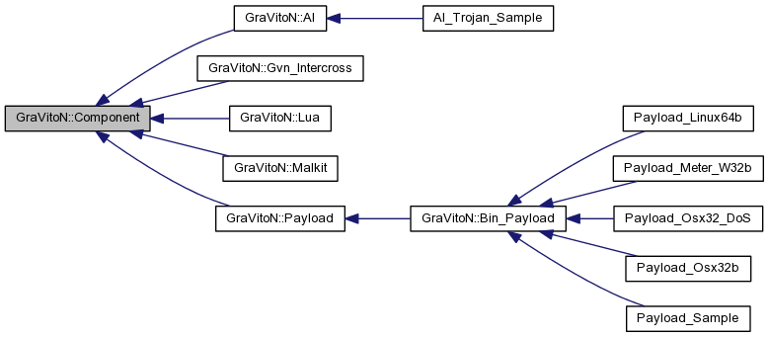
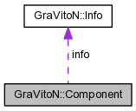
Topic : GraVitoN::Component::About

Slide 23
Let’s Go Code!
Component Class
Info
Initialize
run
Topic : GraVitoN::Component::About

Slide 24
AI
Topic : GraVitoN::AI

Slide 25
Definition:
Imagine GraVitoN as a missile, then AI is the program that is written inside its microprocessors, and designed to guide missile until it destroy the target!
Topic : GraVitoN::AI

Slide 26
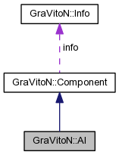
Topic : GraVitoN::AI

Slide 27
We are going to talk about it at AI Samples section of this speech.
Be patient!
Topic : GraVitoN::AI

Slide 28
Payload
Topic : GraVitoN::Payload

Slide 29
Definition
Malicious part of GraVitoN Code, It’s like explosive material in missile head!
Topic : GraVitoN::Payload

Slide 30
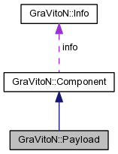
Topic : GraVitoN::Payload

Slide 31
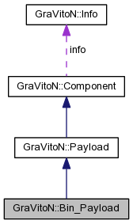
Bin_Payload
A specific type of payloads, designed to execute binary payloads (for example: shellcodes, etc.)
Topic : GraVitoN::Payload

Slide 32
Let’s Go Code!
Msfpayload
Linux Fork
Topic : GraVitoN::Payload

Slide 33
Intercross
Topic : GraVitoN::Intercross

Slide 34
Definition
It’s a component, contains GraVitoN spread techniques.
Virus
Infects Executable
Worm
Exploitation
Topic : GraVitoN::Intercross

Slide 35
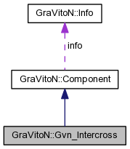
Topic : GraVitoN::Intercross

Slide 36
Generic Infector
Keep It Simple, Smart!
Dark side of all executable binaries: EOF
Pick a valid executable binary file, add some bytes at the end of it, try to execute it. Operating system doesn’t care of those few bytes!
Component
Gvn_Inter_EndOfFile
Topic : GraVitoN::Intercross

Slide 37
Metaworm
Exploit tunneling: Lunch exploits of metasploit against a target .
If exploition process was successful upload a slave to the target.
Msfpayload
Windows: download_execLinux:
Linux: exec (with wget)

Slide 38
Metaworm Master
msfconsole
Metaworm slave
Target
Topic : GraVitoN::Intercross

Slide 39
Lua
Topic : GraVitoN::Lua

Slide 40
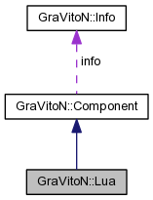
Definition
An Advanced component for advanced developers and advanced AI
Topic : GraVitoN::Lua

Slide 41
Advantages
Run Lua scripts inside GraVitoN
Design dynamic AI
Upgrade your malware, by download new scripts!
Topic : GraVitoN::Lua

Slide 42
Malkit
Topic : GraVitoN::Malkit

Slide 43
Definition
Imagine GraVitoN as a missile again! Every component that designed to improve missile functionality (for example, Gyro (Port Scanner), Laser Defense (A.V Killer), Obstacle Avoidance (IDS Evasion)) is a Malkit.
Topic : GraVitoN::Malkit

Slide 44
Bypass A.V
Topic : GraVitoN::Malkit

Slide 45
Encode/Decode
Types
1. Copy and Decode
Read your encoded payload, decode it and write decoded payload somewhere else in memory
2. In place Decoding
Read your encoded payload and write decoded payload in the same memory address.
Topic : GraVitoN::BypassAV

Slide 46
Encode/Decode
1.Delay: Old school
Sleep
For 1 → 1000000
2.Delay: Creative Method
DNS lookup for imnotexistsonweb7357abcd.com! → Network time-out!
Do it 100 times!
Calculate last prime number lower that 2^64 (unsigned long)
Topic : GraVitoN::BypassAV

Slide 47
Patch
Finding Nemo!
Your binary payload has a signature
Use binary search algorithm to find your AV signature
1. Fill half of your payload with \x00
2. Recompile GraVitoN
3. Check A.V
4. Do this process recursively, again!
Topic : GraVitoN::BypassAV

Slide 48
Patch
Apply your patches
Use Jumps
Always add your extra bytes at the end/beginning of your payload
Reduces risk of wrong jumps
Topic : GraVitoN::BypassAV

Slide 49
Old pay:
1: sub eax, 1
2: cmp eax, 0
3: jle +2
4: jmp -3
5: retn
Wrong Patched pay:
1: add ecx, eax
2: sub ecx, 1
3: mov eax, ecx
4: cmp eax, 0
5: jle +2
6: jmp -3
7: retn
Right Patched pay:
1: jmp +6
2: cmp eax, 0
3: jle +2
4: jmp -2
5: retn
6: sub eax, 1
7: jmp -5
Topic : GraVitoN::BypassAV

Slide 50
Let’s Go Code!
Target: Windows 7 pro Protected By Kaspersky Pure
AI: sample_ai_trojan
Payload: payload_meter_w32b
Topic : GraVitoN::BypassAV

Slide 51
GraVitoN A.I: Samples
Topic : GraVitoN::AI::Samples

Slide 52
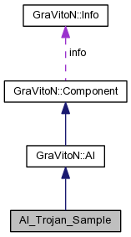
Trojan
A simple trojan has at least 2 components
1. AI
2. Payload
Topic : GraVitoN::AI::Samples

Slide 53
Let’s Go Code!
A 32bit trojan against for Linux
Topic : GraVitoN::AI::Samples

Slide 54
Virus
A simple virus at least has 3 components:
1. AI
2. Payload
3. Intercross
Topic : GraVitoN::AI::Samples

Slide 55
Virus
Advanced Virus
Various Malkits
Multiple AIs managed by a master AI
Multiple Payloads
Multiple Intercross Components
Topic : GraVitoN::AI::Samples

Slide 56
Let’s Go Code!
A Cross OS Virus
Topic : GraVitoN::AI::Samples

Slide 57
Future of the GraVitoN
Topic : GraVitoN::Future

Slide 58
GraVer
Automated code generator
GraVitoN for 6+!
Visualizer
Drag and Drop your components and link them together
Topic : GraVitoN::Future

Slide 59
Add New Payloads
OS
Windows
Apple (OSX and IOS)
Android
Symbian
Hardware
PC
Smart Phone
ARM
Topic : GraVitoN::Future

Slide 60
New Spreading Techniques
More complicated methods
Infect windows driver files (sys files)
Different OS Support
Less AV Detection
Executable Modification Library
PE
ELF
Etc.
Topic : GraVitoN::Future

Slide 61
Sophisticated AIs
AI + Lua
Malkit
Port scanner + Banner grabber
VPN/SSL Support
Topic : GraVitoN::Future

Slide 62
Reporter Component
A valuable gift for pentesters who always are tired of writing those boring pentest reports!
Output
HTTP
SMTP
Topic : GraVitoN::Future

Slide 63
Assembly Obfuscation
An extra tool
Methods
Encode/Decode
Polymorphism
Metamorphism
Topic : GraVitoN::Future

Slide 64
Android and Apple iOS Tests
Compile GraVitoN for android and iOS
Wide community of users
Means more interesting targets for hackers
Topic : GraVitoN::Future

Slide 65
Final word
Topic : GraVitoN::Future

Slide 66
If you are a white hat…
If you are a 814(|< |-|@7…
If you are not a script kiddie…
JOIN GraVitoN Project Now!
http://www.thegraviton.org
Topic : GraVitoN::Future

Slide 67
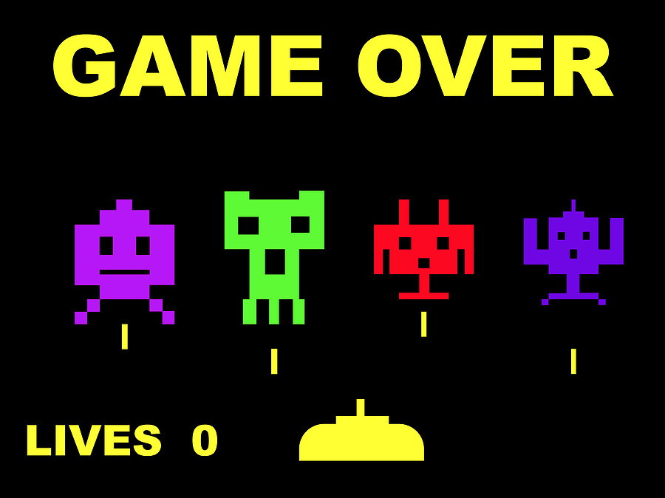
Topic : GraVitoN::Done

